Slide 1
Scientometric Analysis
Yong Liu

Slide 2
Content
Introduction
Data collection
Software use
Result analysis

Slide 3
Introduction
What is scientometric analysis?
Systematic scientometric reviews, empowered by computational and visual analytic approaches, offer opportunities to improve the timeliness, accessibility, and reproducibility of studies of the literature of a field of research (Chen & Song, 2019).
Bibliometrics, informetrics, and scientometrics
The terms bibliometrics, scientometrics, and informetrics refer to component fields related to the study of the dynamics of disciplines as reflected in the production of their literature.
These three terms are used to describe similar and overlapping methodologies (Hood & Wilson, 2001).

Slide 4
Data collection
Database
Web of Science
https://www.webofscience.com/wos/woscc/basic-search
Scopus
https://www.scopus.com/home.uri.
PubMed
https://pubmed.ncbi.nlm.nih.gov/.
Software
CiteSpace (http://cluster.cis.drexel.edu/~cchen/citespace/)
Gephi (https://gephi.org/)
Others, NVivo, VosViewer......

Slide 5
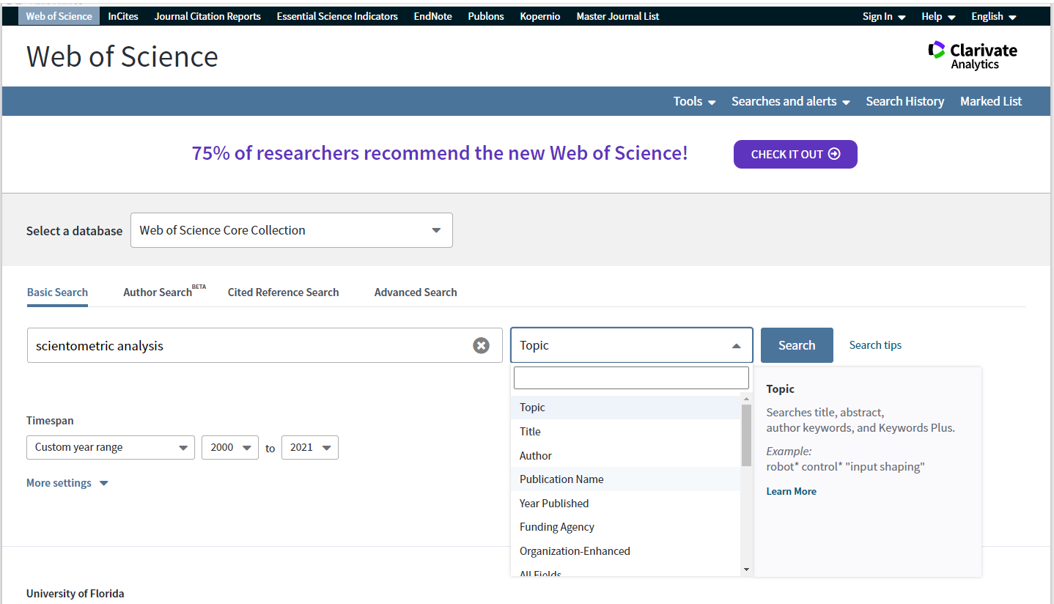
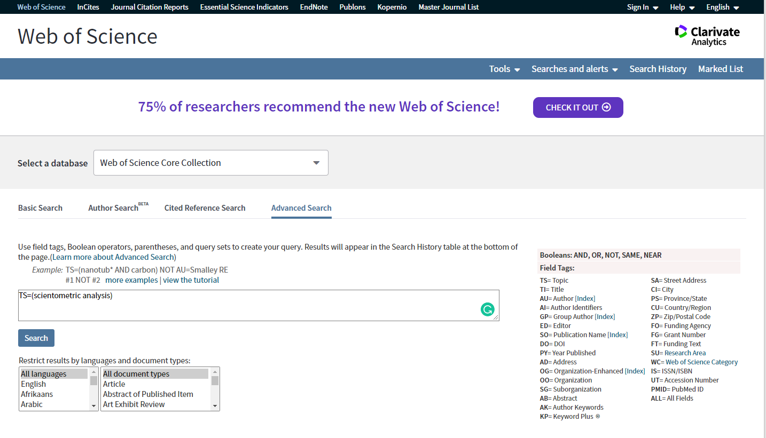
Data collection
Step 1. Search publications
Basic search
Click the buttons
Lack of accuracy
Simply use "scientometric analysis" as an example
Advanced search
Booleans and field tags
Complex
e.g., TS=(nanotub* AND carbon) NOT AU=Smalley RE

Slide 6
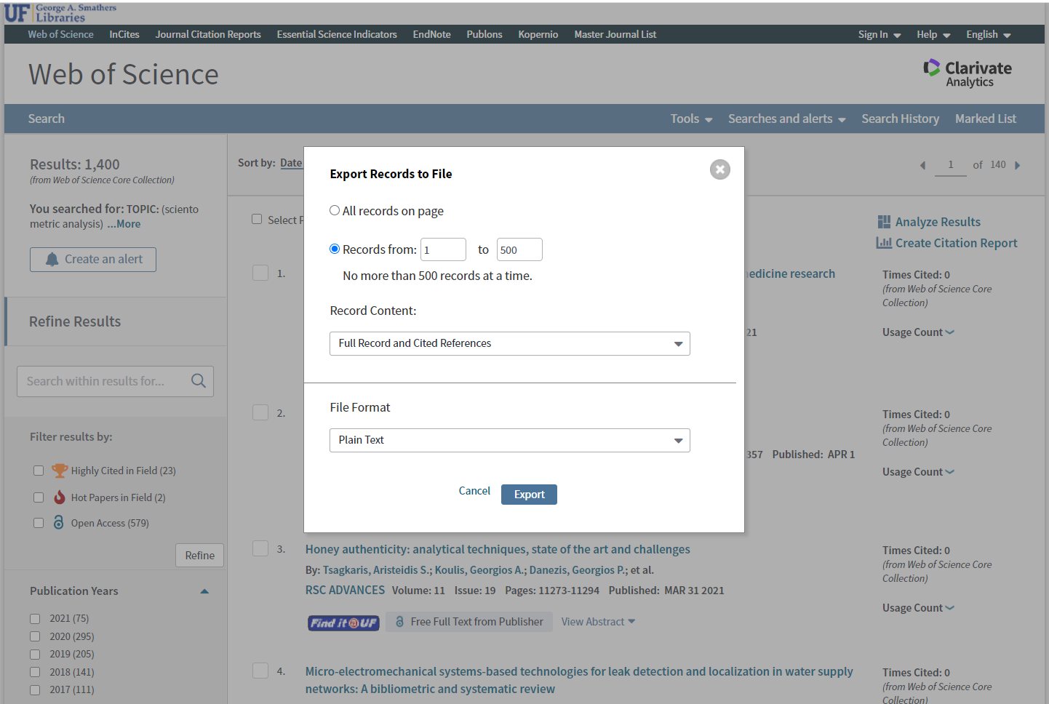
Data collection
Step 2: Download data
Export→ Other File formats
→Plain text →Full record and cited references
Rename the txt files
"download_1", "download_2"….
Create two folders—"data" and "project"
Put txt-files in the "data" folder

Slide 7
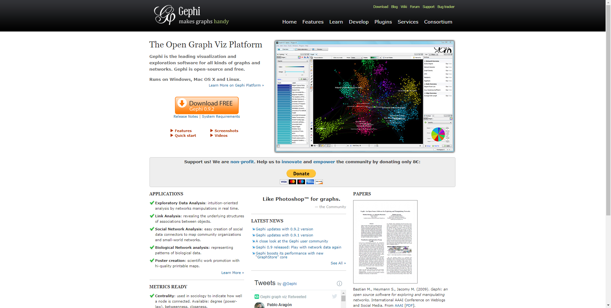
Software use
Step 1: Software installation
CiteSpace (only support Windows)
https://citespace.podia.com/
Gephi (Windows and MacOS)
https://gephi.org/users/download/.

Slide 8
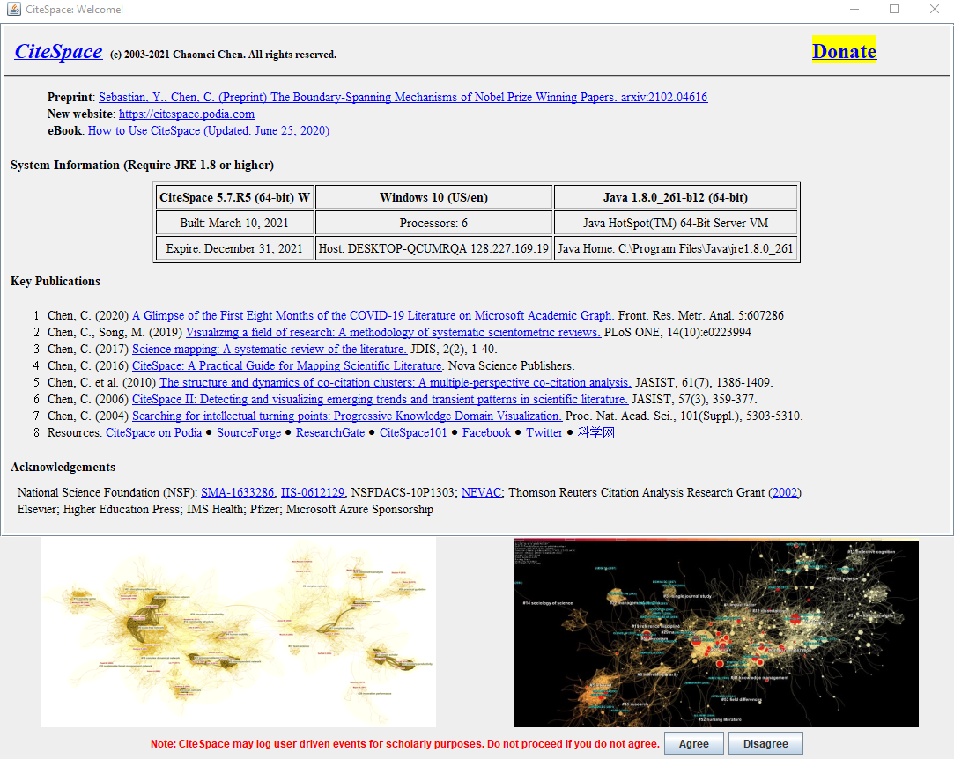
Software use
Step 2: CiteSpace
Open CiteSpace
→ click “agree”

Slide 9
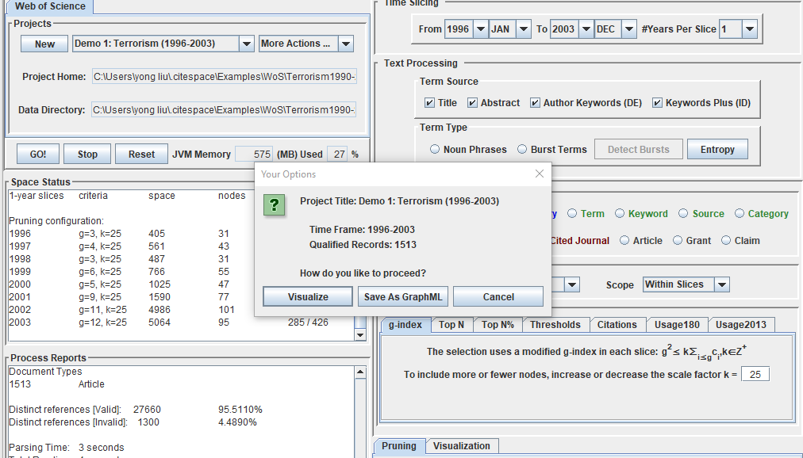
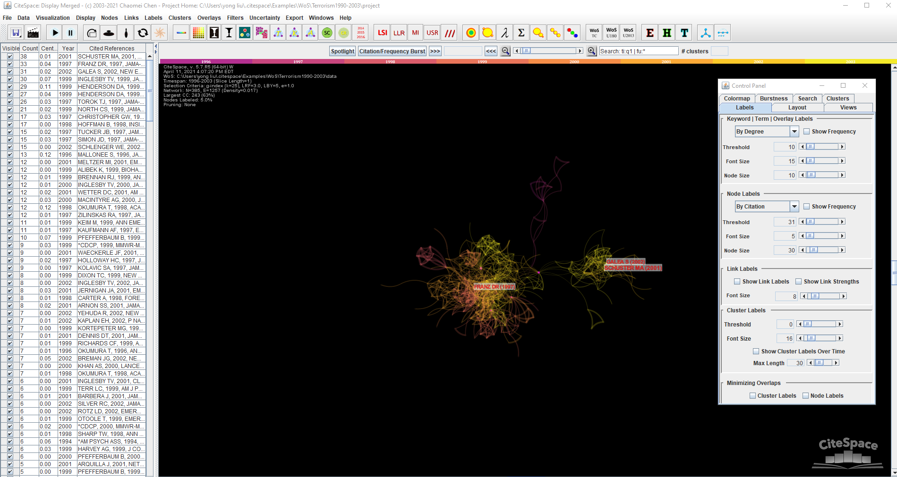
Software use
Try the examples:
Terrorism
Click “Go!”
Click “Visualize”

Slide 10
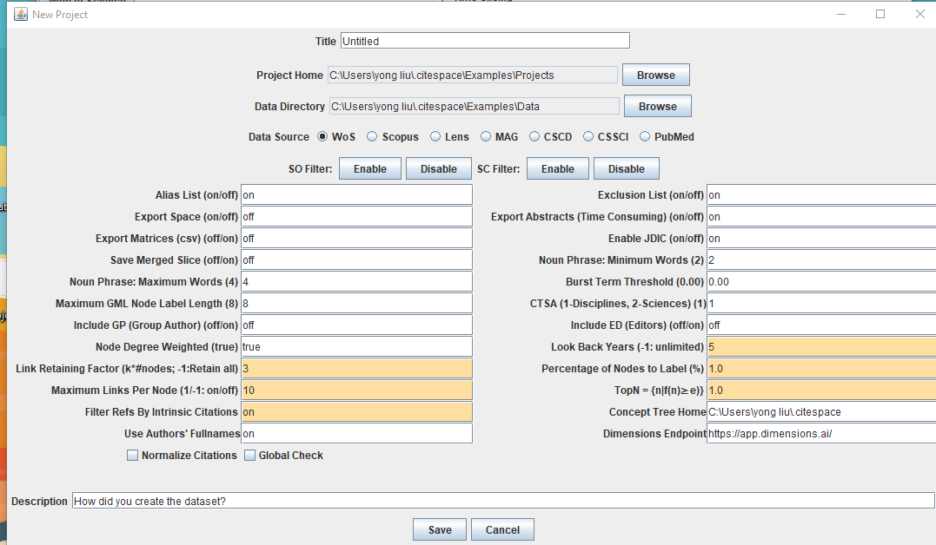
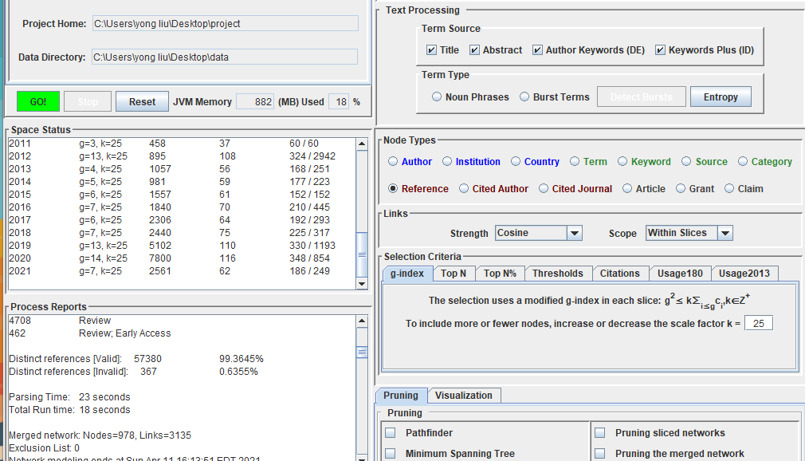
Software use
Create a new project
Click “new”
Rename the “title”
Navigate the project home and data directory
Click “save”
Change the “time slicing”
Double check
Click “Go!”

Slide 12
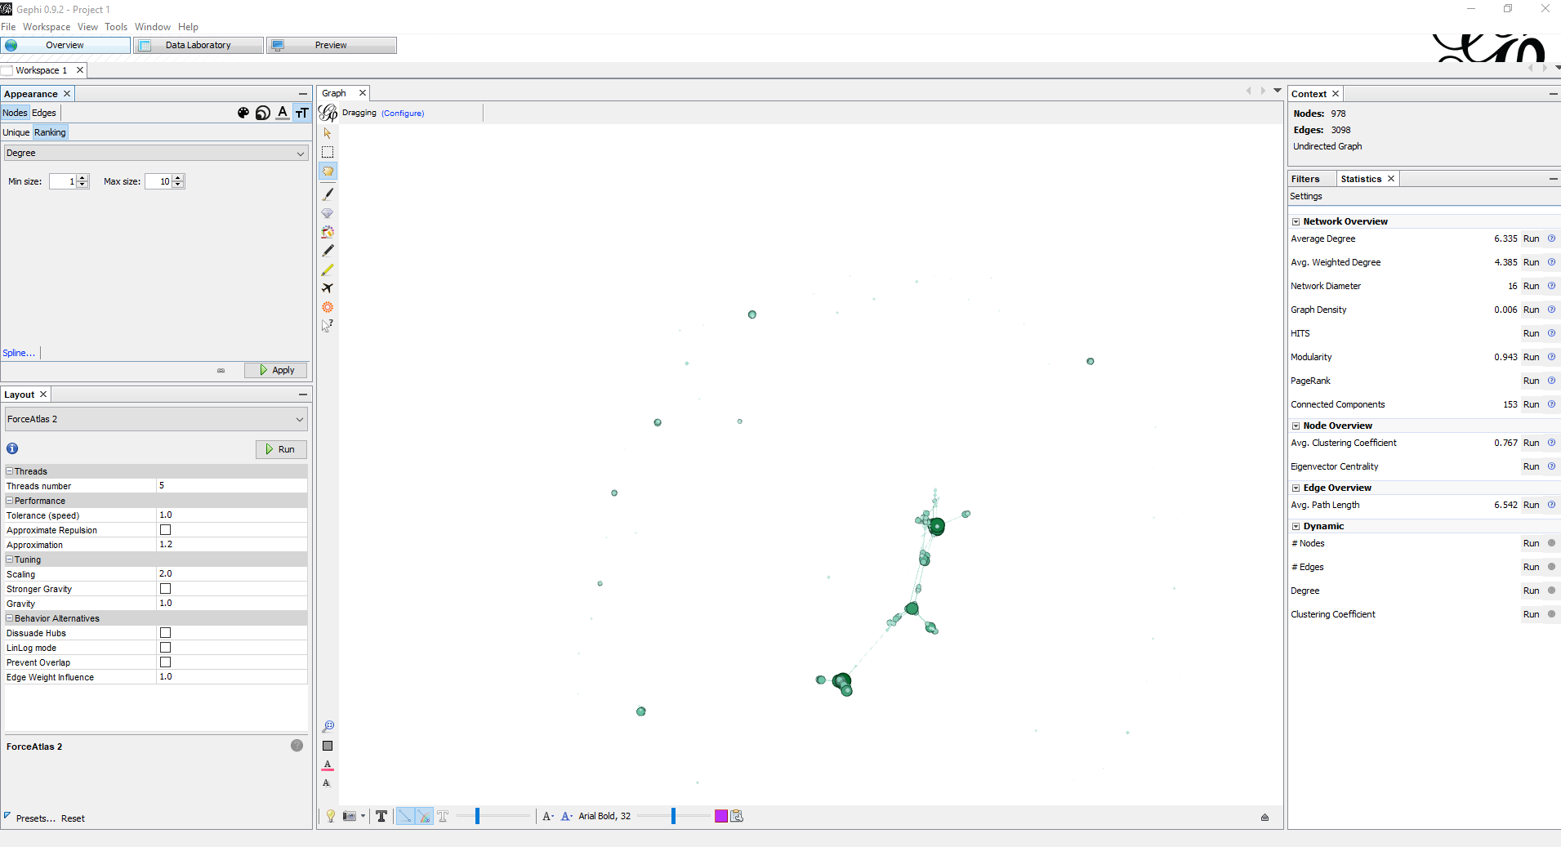
Software use
Step 3: Gephi
Click the graphml file in project folder
This file can be opened with Gephi

Slide 13
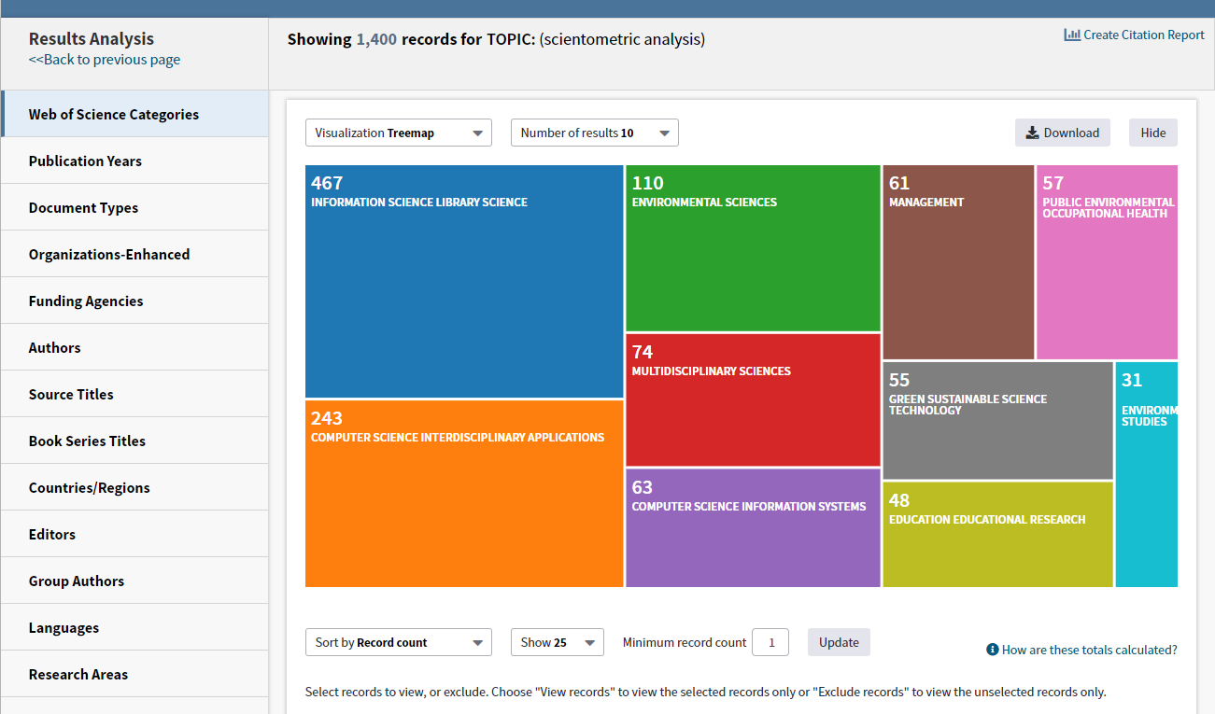
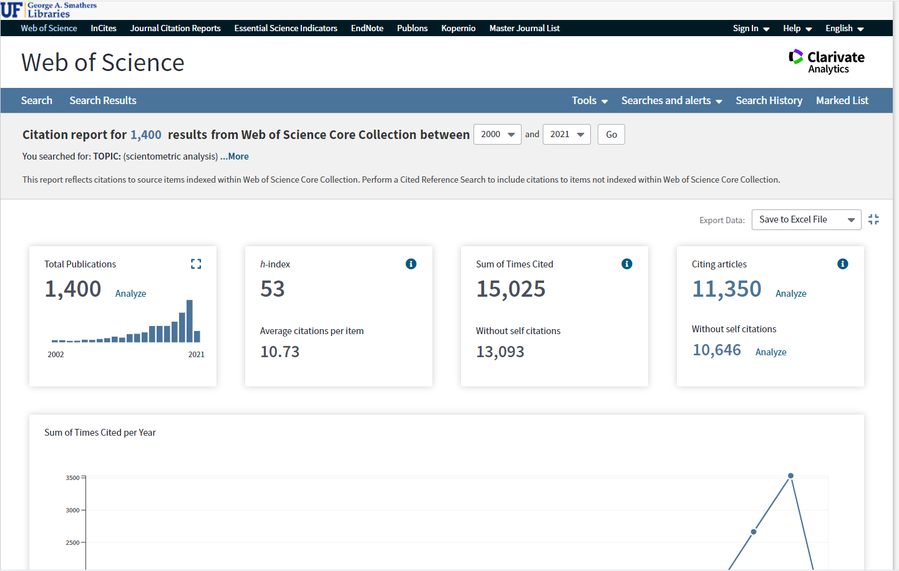
Result analysis
Step 1: Initial analysis with Web of Science
Click “analyze results”
Click “create citation report”

Slide 14
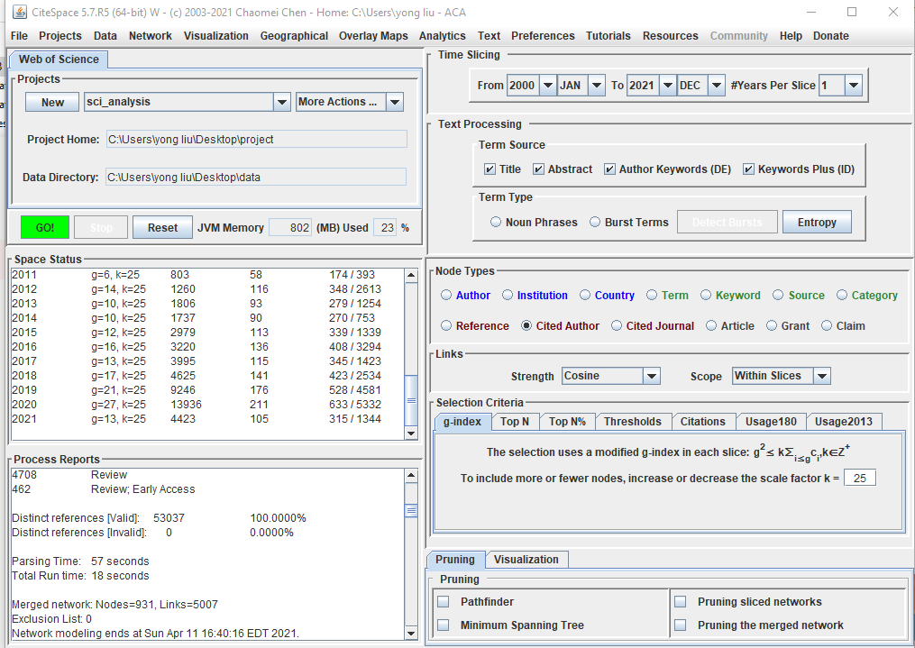
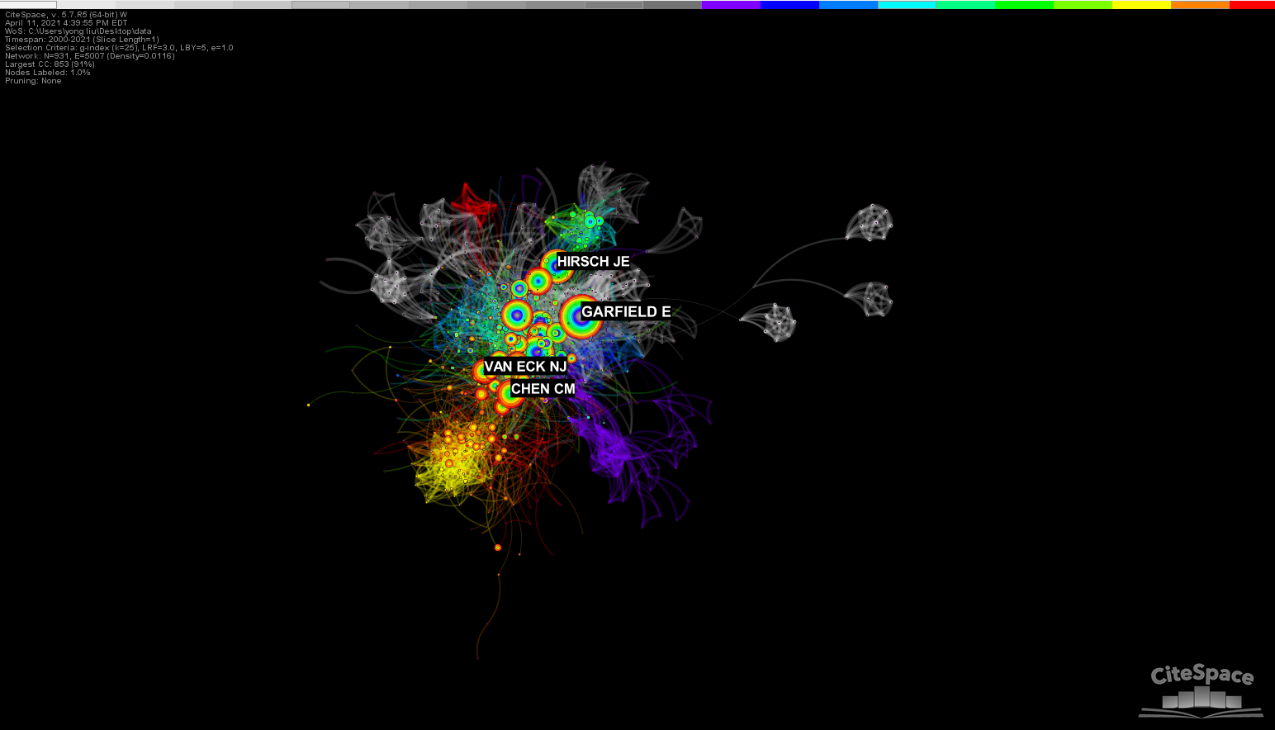
Result analysis
Step 2: Co-citation network analysis
Co-citation is defined as the frequency with which two documents are cited together by other documents.
Reference→ Co-citation analysis
Cited Authors→Author co-citation analysis
Cited Journal →Journal co-citation analysis

Slide 15
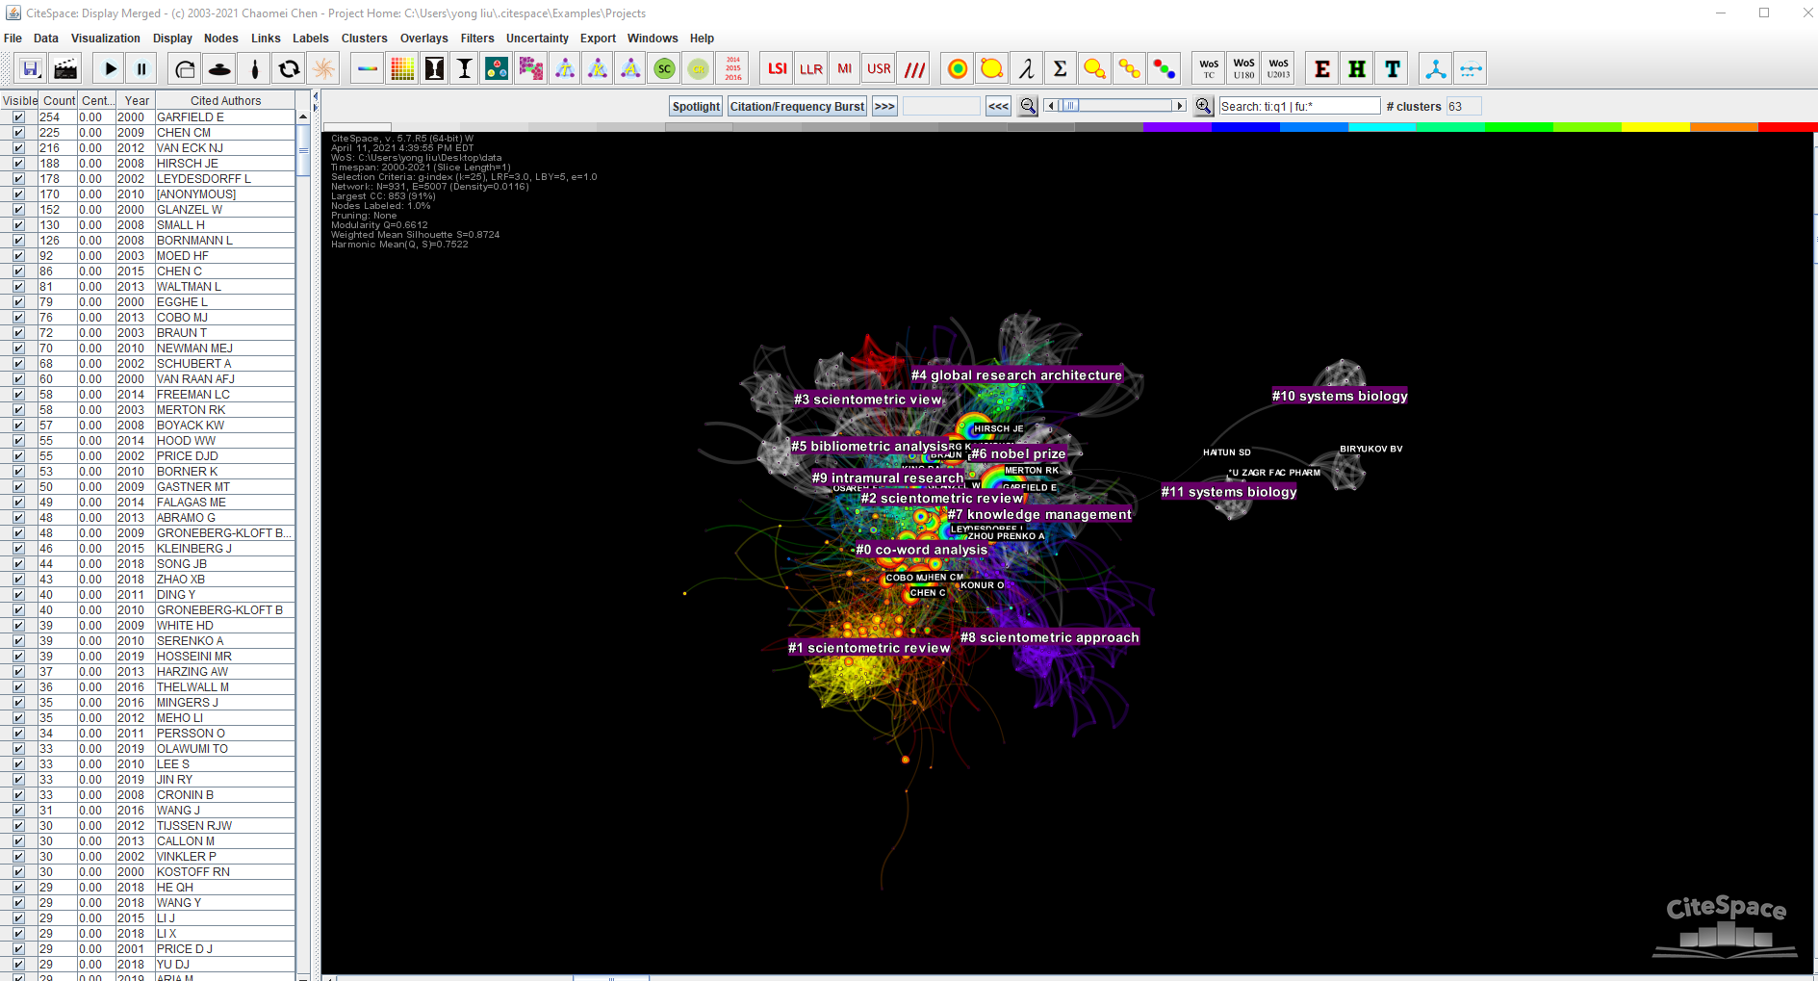
Result analysis
Step 3: Citation-clustering analysis
Click “find clusters”
#0 co-word analysis
#1 scientometric review

Slide 16
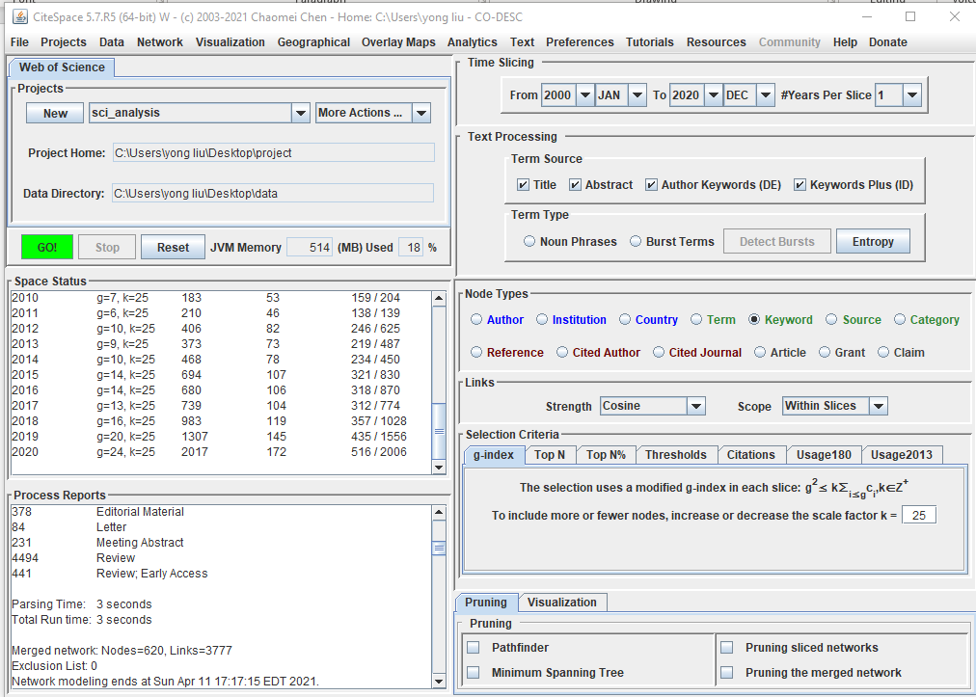
Result Analysis
Step 4: Co-occurrence analysis
Keyword
Could be used to identify research hotspots and frontiers in this domain.

Slide 17
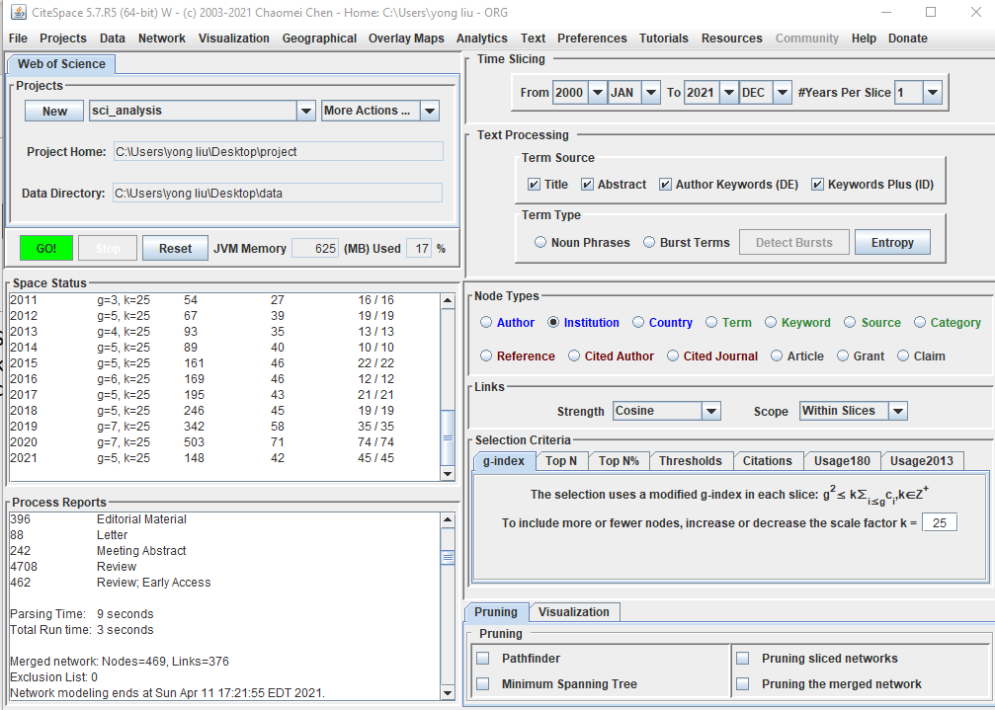
Result Analysis
Step 5: Academic cooperation and knowledge sharing among countries and institutions

Slide 18
Reference
Chen, C., & Song, M. (2019). Visualizing a field of research: A methodology of systematic scientometric reviews. PloS one, 14(10), e0223994.
Hood, W. W., & Wilson, C. S. (2001). The literature of bibliometrics, scientometrics, and informetrics. Scientometrics, 52(2), 291-314.

Slide 19
Thanks!

